Slide 1
W4111 – Introduction to Databases Section 002, Spring 2022 Lecture 7: ER, Relational, SQL (End)
© Donald F. Ferguson, 2022

Slide 2

Contents
2 | Introduction to Databases (S22): Lecture 7: ER, Relational, SQL (End) © Donald F. Ferguson, 2022

Slide 3
Contents
Midterm and homework assignments.
Cursors revisited.
Functions, procedures and triggers.
Security.
Some advanced ER concepts.
Worked example – modeling Columbia University and showing:
Complex ER (inheritance)
Views
Constraints
Indexes
Procedures, Functions, Triggers
And showing how to “get data from the web.”

Slide 4
Midterm and Homework Assignments
4 | Introduction to Databases (S22): Lecture 7: ER, Relational, SQL (End) © Donald F. Ferguson, 2022

Slide 5
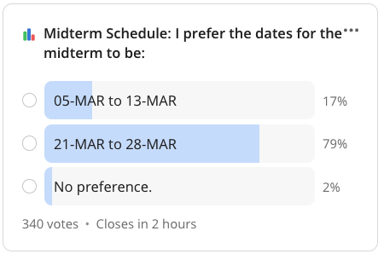
Exams and Homework
There is a clear preference.
This is midterm week.
Not assigning HW3 this week.
Giving you a break, at lead for my class.
Current tentative schedule:
Midterm: 20-MAR to 27-MAR.
HW3: 27-MAR to 09-APR.
HW4: 10-MAR to 23-MAR.
HW5: 24-MAR to 03-MAY.
Final: 03-MAY to 10-MAY

Slide 6
Cursors (Switch to Notebook)
6 | Introduction to Databases (S22): Lecture 7: ER, Relational, SQL (End) © Donald F. Ferguson, 2022

Slide 7
Comments
This was a very inefficient way to implement the transformation.
“select * from name_basics” computes the result set all at once. We will also see that this can cause locking/concurrency control issues.
I could have done the loop without using fetchmany() by counting how many rows the application has already processed.
cursor.execute( “select * from name_basics limit 10 offset %s”, (read_count) )
I should have also “batched the inserts” by sending all 10 rows in one insert.
We will see in Module III that there are systems and frameworks optimized for extract-transform-load to perform these tasks.
I was simply explaining cursors.

Slide 8
Functions, Procedures, Triggers
8 | Introduction to Databases (S22): Lecture 7: ER, Relational, SQL (End) © Donald F. Ferguson, 2022

Slide 9

Concepts
9 | Introduction to Databases (S22): Lecture 7: ER, Relational, SQL (End) © Donald F. Ferguson, 2022

Slide 10
Functions and Procedures
Functions and procedures allow “business logic” to be stored in the database and executed from SQL statements.
These can be defined either by the procedural component of SQL or by an external programming language such as Java, C, or C++.
The syntax we present here is defined by the SQL standard.
Most databases implement nonstandard versions of this syntax.
Note:
The programming language, runtime and tools for functions, procedures and triggers are not easy to use.
My view is that calling external functions is an anti-pattern (bad idea).
External code degrades the reliability, security and performance of the database.
Databases are often mission critical and the heart of environments.

Slide 11
Language Constructs for Procedures & Functions
SQL supports constructs that gives it almost all the power of a general-purpose programming language.
Warning: most database systems implement their own variant of the standard syntax below.
Compound statement: begin … end,
May contain multiple SQL statements between begin and end.
Local variables can be declared within a compound statements
While and repeat statements:
while boolean expression do
sequence of statements ;
end while
repeat
sequence of statements ;
until boolean expression
end repeat

Slide 12
(Core) Language Constructs (Cont.)
For loop
Permits iteration over all results of a query
Example: Find the budget of all departments declare n integer default 0; for r as select budget from department where dept_name = 'Music' do set n = n + r.budget end for
Note:
There are various other looping constructs.

Slide 13
(Core) Language Constructs – if-then-else
Conditional statements (if-then-else)
if boolean expression then statement or compound statement elseif boolean expression then statement or compound statement else statement or compound statement end if
Note:
We will not spend a lot of time writing functions, procedures, or triggers.
The language and development environment are not easy to use.

Slide 14
Functions
14 | Introduction to Databases (S22): Lecture 7: ER, Relational, SQL (End) © Donald F. Ferguson, 2022

Slide 15
Declaring SQL Functions
Define a function that, given the name of a department, returns the count of the number of instructors in that department.
create function dept_count (dept_name varchar(20)) returns integer begin declare d_count integer; select count (* ) into d_count from instructor where instructor.dept_name = dept_name return d_count; end
The function dept_count can be used to find the department names and budget of all departments with more that 12 instructors.
select dept_name, budget from department where dept_count (dept_name ) > 12

Slide 16
Table Functions
The SQL standard supports functions that can return tables as results; such functions are called table functions
Example: Return all instructors in a given department
create function instructor_of (dept_name char(20))
returns table (
ID varchar(5), name varchar(20), dept_name varchar(20), salary numeric(8,2))
return table (select ID, name, dept_name, salary from instructor where instructor.dept_name = instructor_of.dept_name)
Usage
select * from table (instructor_of ('Music'))

Slide 17
Procedures
17 | Introduction to Databases (S22): Lecture 7: ER, Relational, SQL (End) © Donald F. Ferguson, 2022

Slide 18
SQL Procedures
The dept_count function could instead be written as procedure:
create procedure dept_count_proc (in dept_name varchar(20), out d_count integer) begin
select count(*) into d_count from instructor where instructor.dept_name = dept_count_proc.dept_name
end
The keywords in and out are parameters that are expected to have values assigned to them and parameters whose values are set in the procedure in order to return results.
Procedures can be invoked either from an SQL procedure or from embedded SQL, using the call statement.
declare d_count integer; call dept_count_proc( 'Physics', d_count);

Slide 19
SQL Procedures (Cont.)
Procedures and functions can be invoked also from dynamic SQL
SQL allows more than one procedure of the so long as the number of arguments of the procedures with the same name is different.
The name, along with the number of arguments, is used to identify the procedure.

Slide 20
Triggers
20 | Introduction to Databases (S22): Lecture 7: ER, Relational, SQL (End) © Donald F. Ferguson, 2022

Slide 21
Triggers
A trigger is a statement that is executed automatically by the system as a side effect of a modification to the database.
To design a trigger mechanism, we must:
Specify the conditions under which the trigger is to be executed.
Specify the actions to be taken when the trigger executes.
Triggers introduced to SQL standard in SQL:1999, but supported even earlier using non-standard syntax by most databases.
Syntax illustrated here may not work exactly on your database system; check the system manuals

Slide 22
Triggering Events and Actions in SQL
Triggering event can be insert, delete or update
Triggers on update can be restricted to specific attributes
For example, after update of takes on grade
Values of attributes before and after an update can be referenced
referencing old row as : for deletes and updates
referencing new row as : for inserts and updates
Triggers can be activated before an event, which can serve as extra constraints. For example, convert blank grades to null.
create trigger setnull_trigger before update of takes referencing new row as nrow for each row when (nrow.grade = ' ') begin atomic set nrow.grade = null; end;

Slide 23
Trigger to Maintain credits_earned value
create trigger credits_earned after update of takes on (grade) referencing new row as nrow referencing old row as orow for each row when nrow.grade <> 'F' and nrow.grade is not null and (orow.grade = 'F' or orow.grade is null) begin atomic update student set tot_cred= tot_cred + (select credits from course where course.course_id= nrow.course_id) where student.id = nrow.id; end;

Slide 24
Statement Level Triggers
Instead of executing a separate action for each affected row, a single action can be executed for all rows affected by a transaction
Use for each statement instead of for each row
Use referencing old table or referencing new table to refer to temporary tables (called transition tables) containing the affected rows
Can be more efficient when dealing with SQL statements that update a large number of rows

Slide 25
When Not To Use Triggers
Triggers were used earlier for tasks such as
Maintaining summary data (e.g., total salary of each department)
Replicating databases by recording changes to special relations (called change or delta relations) and having a separate process that applies the changes over to a replica
There are better ways of doing these now:
Databases today provide built in materialized view facilities to maintain summary data
Databases provide built-in support for replication
Encapsulation facilities can be used instead of triggers in many cases
Define methods to update fields
Carry out actions as part of the update methods instead of through a trigger

Slide 26
When Not To Use Triggers (Cont.)
Risk of unintended execution of triggers, for example, when
Loading data from a backup copy
Replicating updates at a remote site
Trigger execution can be disabled before such actions.
Other risks with triggers:
Error leading to failure of critical transactions that set off the trigger
Cascading execution

Slide 27
Summary
27 | Introduction to Databases (S22): Lecture 7: ER, Relational, SQL (End) © Donald F. Ferguson, 2022

Slide 28
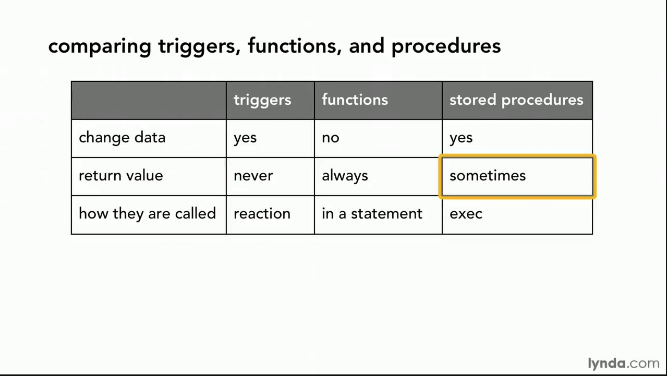
Comparison

Slide 29
Comparison – Some Details
A trigger has capabilities like a procedure, except ...
You do not call it. The DB engine calls it before or after an INSERT, UPDATE, DELETE.
The inputs are the list of incoming new, modified rows.
The outputs are the modified versions of the new or modified rows.

Slide 30
Examples Function: compute batting average. (Lahman’s baseball DB)
Trigger: Make student ID immutable. (Book database)
Procedure: Add customer and address (Classic Models modified)
30 | Introduction to Databases (S22): Lecture 7: ER, Relational, SQL (End) © Donald F. Ferguson, 2022

Slide 31
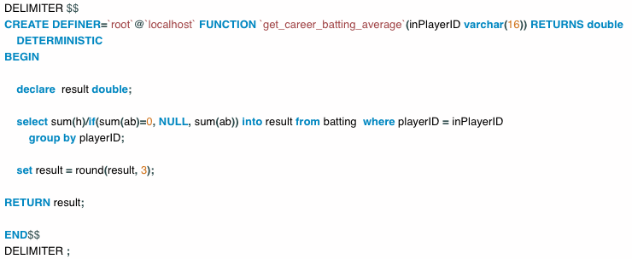
Function to Computer Career Batting Avg

Slide 32
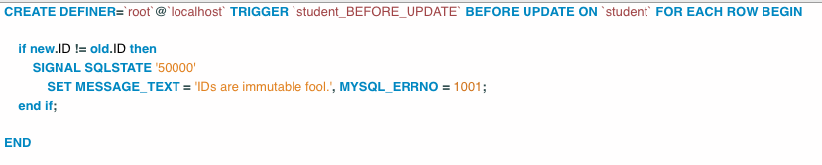
Trigger to Make Student ID Immutable
In general, DEFINER= ... Is extremely important.
This allows DBA to implement functions that access data/do things that a general user cannot do.

Slide 33
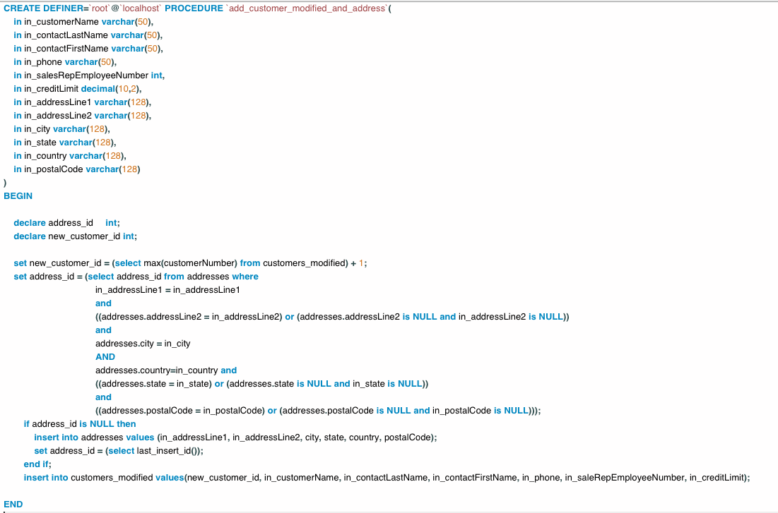
Add User and Address to Modified Classic Models
Part of HW2 Answer

Slide 34
Security
34 | Introduction to Databases (S22): Lecture 7: ER, Relational, SQL (End) © Donald F. Ferguson, 2022

Slide 35
Security Concepts (Terms from Wikipedia)
Definitions:
“A (digital) identity is information on an entity used by computer systems to represent an external agent. That agent may be a person, organization, application, or device.”
“Authentication is the act of proving an assertion, such as the identity of a computer system user. In contrast with identification, the act of indicating a person or thing's identity, authentication is the process of verifying that identity.”
“Authorization is the function of specifying access rights/privileges to resources, ... More formally, "to authorize" is to define an access policy. ... During operation, the system uses the access control rules to decide whether access requests from (authenticated) consumers shall be approved (granted) or disapproved.
“Within an organization, roles are created for various job functions. The permissions to perform certain operations are assigned to specific roles. Members or staff (or other system users) are assigned particular roles, and through those role assignments acquire the permissions needed to perform particular system functions.”
“In computing, privilege is defined as the delegation of authority to perform security-relevant functions on a computer system. A privilege allows a user to perform an action with security consequences. Examples of various privileges include the ability to create a new user, install software, or change kernel functions.”
SQL and relational database management systems implementing security by:
Creating identities and authentication policies.
Creating roles and assigning identities to roles.
Granting and revoking privileges to/from roles and identities.

Slide 36
Authorization
We may assign a user several forms of authorizations on parts of the database.
Read - allows reading, but not modification of data.
Insert - allows insertion of new data, but not modification of existing data.
Update - allows modification, but not deletion of data.
Delete - allows deletion of data.
Each of these types of authorizations is called a privilege. We may authorize the user all, none, or a combination of these types of privileges on specified parts of a database, such as a relation or a view.

Slide 37
Authorization (Cont.)
Forms of authorization to modify the database schema
Index - allows creation and deletion of indices.
Resources - allows creation of new relations.
Alteration - allows addition or deletion of attributes in a relation.
Drop - allows deletion of relations.

Slide 38
Authorization Specification in SQL
The grant statement is used to confer authorization
grant <privilege list> on <relation or view > to <user list>
<user list> is:
a user-id
public, which allows all valid users the privilege granted
A role (more on this later)
Example:
grant select on department to Amit, Satoshi
Granting a privilege on a view does not imply granting any privileges on the underlying relations.
The grantor of the privilege must already hold the privilege on the specified item (or be the database administrator).

Slide 39
Privileges in SQL
select: allows read access to relation, or the ability to query using the view
Example: grant users U₁, U₂, and U₃ select authorization on the instructor relation:
grant select on instructor to U₁, U₂, U₃
insert: the ability to insert tuples
update: the ability to update using the SQL update statement
delete: the ability to delete tuples.
all privileges: used as a short form for all the allowable privileges

Slide 40
Revoking Authorization in SQL
The revoke statement is used to revoke authorization.
revoke <privilege list> on <relation or view> from <user list>
Example:
revoke select on student from U₁, U₂, U₃
<privilege-list> may be all to revoke all privileges the revokee may hold.
If <revokee-list> includes public, all users lose the privilege except those granted it explicitly.
If the same privilege was granted twice to the same user by different grantees, the user may retain the privilege after the revocation.
All privileges that depend on the privilege being revoked are also revoked.

Slide 41
Roles
A role is a way to distinguish among various users as far as what these users can access/update in the database.
To create a role we use:
create a role <name>
Example:
create role instructor
Once a role is created we can assign “users” to the role using:
grant <role> to <users>

Slide 42
Roles Example
create role instructor;
grant instructor to Amit;
Privileges can be granted to roles:
grant select on takes to instructor;
Roles can be granted to users, as well as to other roles
create role teaching_assistant
grant teaching_assistant to instructor;
Instructor inherits all privileges of teaching_assistant
Chain of roles
create role dean;
grant instructor to dean;
grant dean to Satoshi;

Slide 43
Authorization on Views
create view geo_instructor as (select * from instructor where dept_name = 'Geology');
grant select on geo_instructor to geo_staff
Suppose that a geo_staff member issues
select * from geo_instructor;
What if
geo_staff does not have permissions on instructor?
Creator of view did not have some permissions on instructor?

Slide 44
Other Authorization Features
references privilege to create foreign key
grant reference (dept_name) on department to Mariano;
Why is this required?
transfer of privileges
grant select on department to Amit with grant option;
revoke select on department from Amit, Satoshi cascade;
revoke select on department from Amit, Satoshi restrict;
And more!
Note:
Like in many other cases, SQL DBMS have product specific variations.
Switch to notebook.

Slide 45
Some Advanced ER Concepts
45 | Introduction to Databases (S22): Lecture 7: ER, Relational, SQL (End) © Donald F. Ferguson, 2022

Slide 46
Weak Entity Sets
Consider a section entity, which is uniquely identified by a course_id, semester, year, and sec_id.
Clearly, section entities are related to course entities. Suppose we create a relationship set sec_course between entity sets section and course.
Note that the information in sec_course is redundant, since section already has an attribute course_id, which identifies the course with which the section is related.
One option to deal with this redundancy is to get rid of the relationship sec_course; however, by doing so the relationship between section and course becomes implicit in an attribute, which is not desirable.

Slide 47
Weak Entity Sets (Cont.)
An alternative way to deal with this redundancy is to not store the attribute course_id in the section entity and to only store the remaining attributes section_id, year, and semester.
However, the entity set section then does not have enough attributes to identify a particular section entity uniquely
To deal with this problem, we treat the relationship sec_course as a special relationship that provides extra information, in this case, the course_id, required to identify section entities uniquely.
A weak entity set is one whose existence is dependent on another entity, called its identifying entity
Instead of associating a primary key with a weak entity, we use the identifying entity, along with extra attributes called discriminator to uniquely identify a weak entity.

Slide 48
Weak Entity Sets (Cont.)
An entity set that is not a weak entity set is termed a strong entity set.
Every weak entity must be associated with an identifying entity; that is, the weak entity set is said to be existence dependent on the identifying entity set.
The identifying entity set is said to own the weak entity set that it identifies.
The relationship associating the weak entity set with the identifying entity set is called the identifying relationship.
Note that the relational schema we eventually create from the entity set section does have the attribute course_id, for reasons that will become clear later, even though we have dropped the attribute course_id from the entity set section.

Slide 49
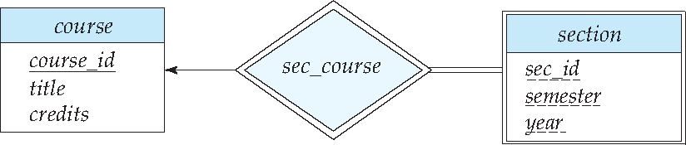
Expressing Weak Entity Sets
In E-R diagrams, a weak entity set is depicted via a double rectangle.
We underline the discriminator of a weak entity set with a dashed line.
The relationship set connecting the weak entity set to the identifying strong entity set is depicted by a double diamond.
Primary key for section – (course_id, sec_id, semester, year)

Slide 50
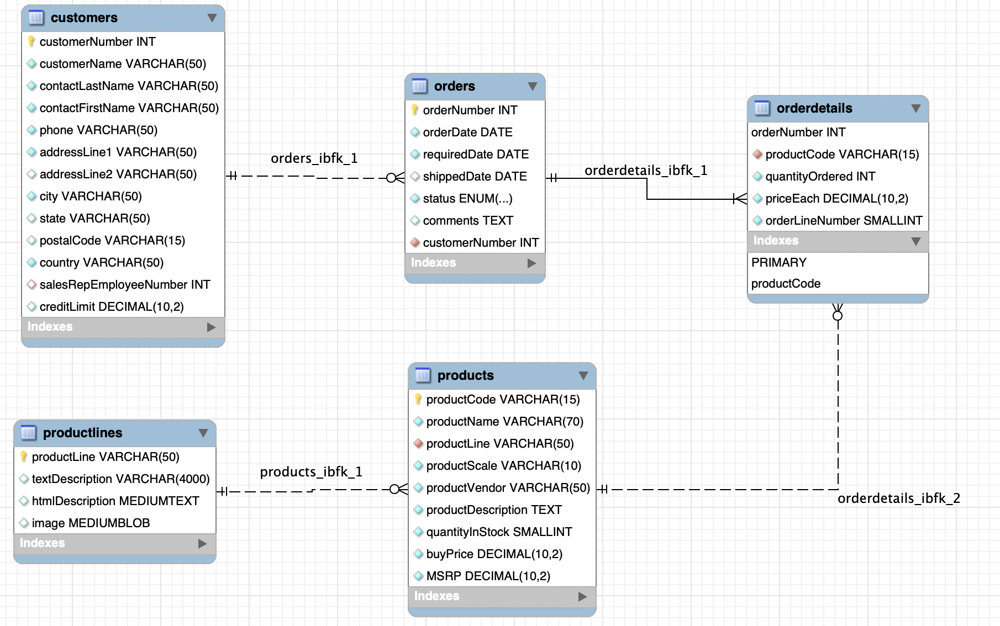
An Example – Classic Models
https://www.mysqltutorial.org/mysql-sample-database.aspx/
50 | Introduction to Databases (S22): Lecture 7: ER, Relational, SQL (End)

Slide 51
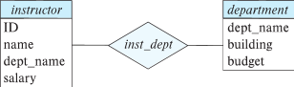
Redundant Attributes
Suppose we have entity sets:
instructor, with attributes: ID, name, dept_name, salary
department, with attributes: dept_name, building, budget
We model the fact that each instructor has an associated department using a relationship set inst_dept
The attribute dept_name in instructor replicates information present in the relationship and is therefore redundant
and needs to be removed.
BUT: when converting back to tables, in some cases the attribute gets reintroduced, as we will see later.

Slide 52
Design Alternatives
In designing a database schema, we must ensure that we avoid two major pitfalls:
Redundancy: a bad design may result in repeat information.
Redundant representation of information may lead to data inconsistency among the various copies of information
Incompleteness: a bad design may make certain aspects of the enterprise difficult or impossible to model.
Avoiding bad designs is not enough. There may be a large number of good designs from which we must choose.
Emphasis Added
Notes:
52

Slide 53
Aggregation
Consider the ternary relationship proj_guide, which we saw earlier
Suppose we want to record evaluations of a student by a guide on a project

Slide 54
Aggregation (Cont.)
Relationship sets eval_for and proj_guide represent overlapping information
Every eval_for relationship corresponds to a proj_guide relationship
However, some proj_guide relationships may not correspond to any eval_for relationships
So we can’t discard the proj_guide relationship
Eliminate this redundancy via aggregation
Treat relationship as an abstract entity
Allows relationships between relationships
Abstraction of relationship into new entity

Slide 55
Aggregation (Cont.)
Eliminate this redundancy via aggregation without introducing redundancy, the following diagram represents:
A student is guided by a particular instructor on a particular project
A student, instructor, project combination may have an associated evaluation
Notes:
55

Slide 56
Reduction to Relational Schemas
To represent aggregation, create a schema containing
Primary key of the aggregated relationship,
The primary key of the associated entity set
Any descriptive attributes
In our example:
The schema eval_for is:
eval_for (s_ID, project_id, i_ID, evaluation_id)
The schema proj_guide is redundant.

Slide 57
Specialization
Top-down design process; we designate sub-groupings within an entity set that are distinctive from other entities in the set.
These sub-groupings become lower-level entity sets that have attributes or participate in relationships that do not apply to the higher-level entity set.
Depicted by a triangle component labeled ISA (e.g., instructor “is a” person).
Attribute inheritance – a lower-level entity set inherits all the attributes and relationship participation of the higher-level entity set to which it is linked.

Slide 58
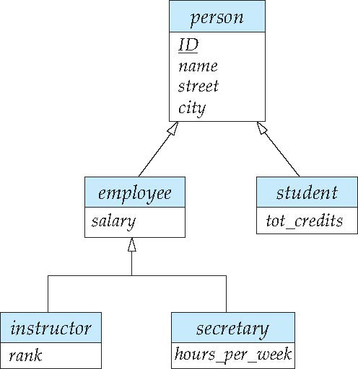
Specialization Example
Overlapping – employee and student
Disjoint – instructor and secretary
Total and partial

Slide 59
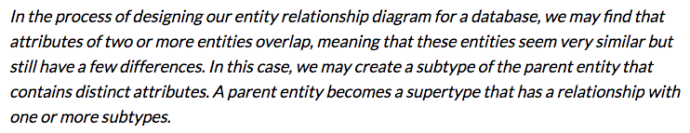
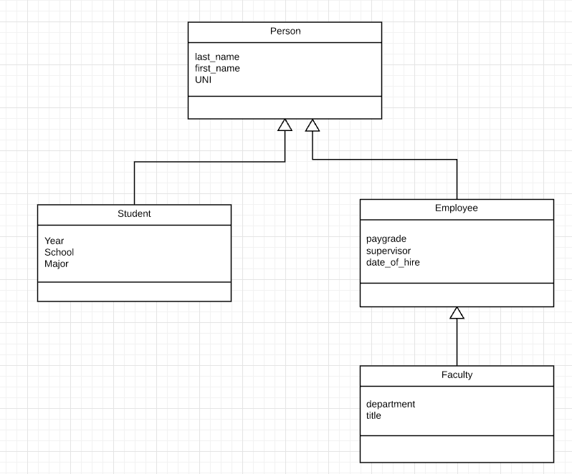
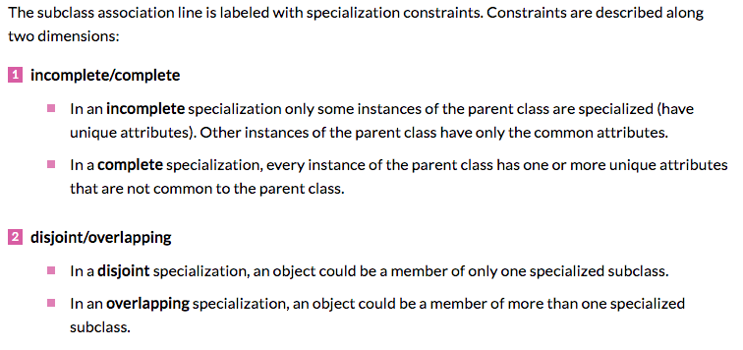
Inheritance, IsA, Specialization
Are all employees faculty?
Can students also be employees?
http://www.vertabelo.com/blog/technical-articles/inheritance-in-a-relational-database
59 | W4111_02_F20: Introduction to Databases – Lecture 6

Slide 60
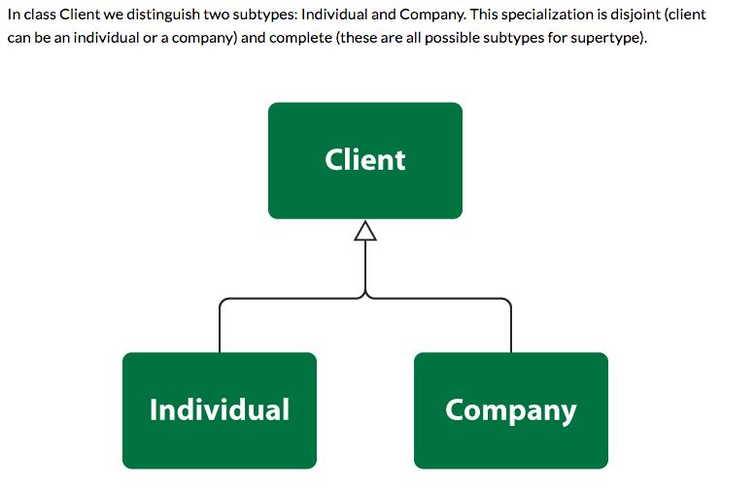
Simpler Example
60 | W4111_02_F20: Introduction to Databases – Lecture 6

Slide 61
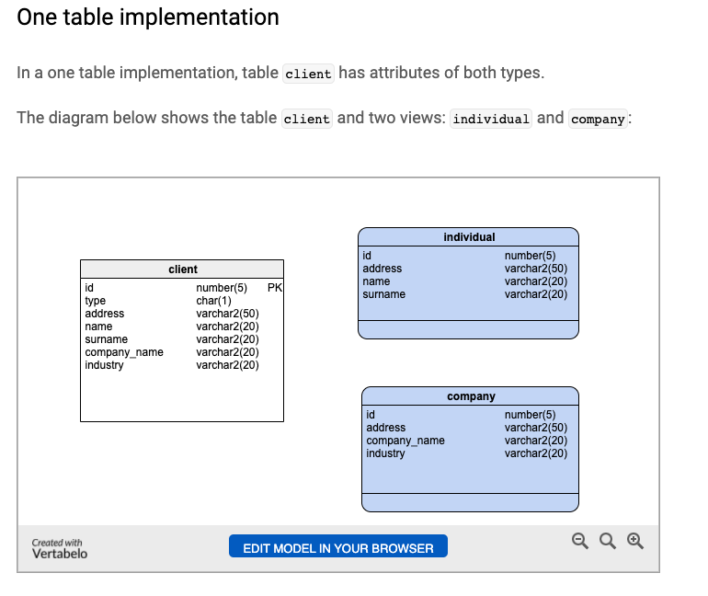
One Table Implementation
Views
Tables

Slide 62
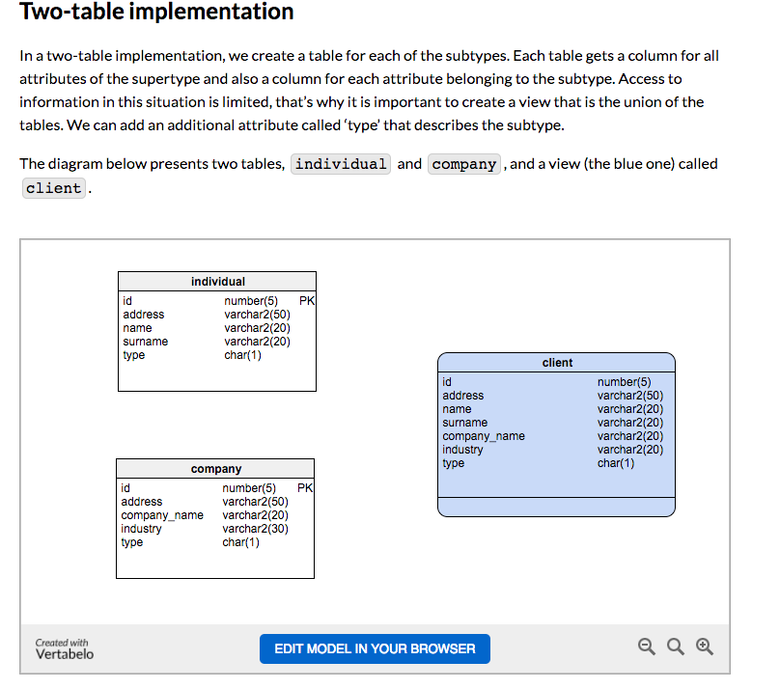
Two Table Implementation
View
Tables
62 | W4111_02_F20: Introduction to Databases – Lecture 6

Slide 63
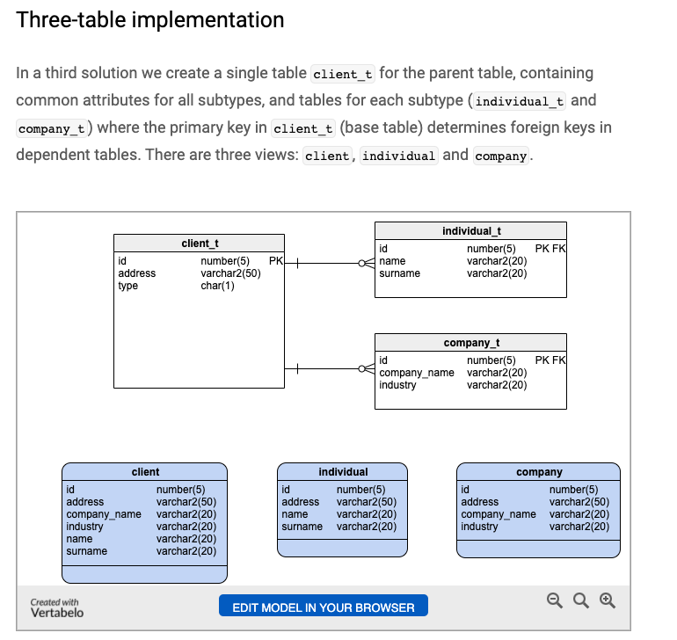
Two Table Implementation
Tables
Views
63 | W4111_02_F20: Introduction to Databases – Lecture 6

Slide 64
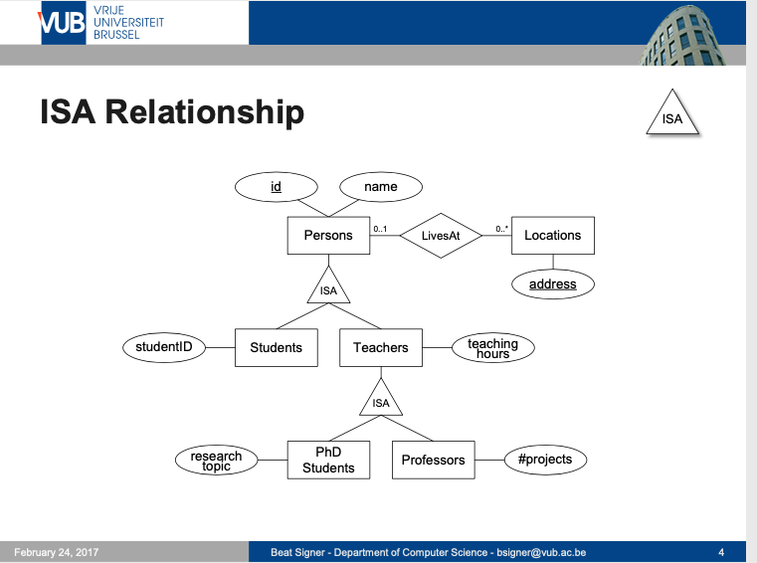
Modeling
64 | W4111_02_F20: Introduction to Databases – Lecture 6

Slide 65
ER vs. UML Class Diagrams
ER Diagram Notation
Equivalent in UML
I use this approach in Crow’s Foot Notation but that is not standard.
* Generalization can use merged or separate arrows independent
of disjoint/overlapping

Slide 66
Faculty, Student Inheritance Example
66 | Introduction to Databases (S22): Lecture 7: ER, Relational, SQL (End) © Donald F. Ferguson, 2022

Slide 67
Topics
Departments table – show how I got the data.
Generating test data.
Two table pattern for inheritance. Descriminator in the view.
ER diagram convention.
DDL
Generate UNI with a function.
Make the UNI immutable with a trigger.
Check constraint on enrollment versus graduation date.
Procedure for creating/updating/etc a person.
Hiding sensitive information.
Keys and indexes: UNI, email, names, department

